Slide 1


Natural Language Processing
(DSCI-6004-01)
Airline Twitter Feedback Analysis
TEAM MEMBERS:
- JASHWANTH SURVI

Slide 2
Statement of Project Objectives
As we know, the opinions collected from Twitter are often presented in an unstructured textual format. Processing the data and analyzing the feedbacks to better the products and services
Analyzing unstructured data can be a challenging, time-intensive, and expensive task. Despite this, businesses can utilize sentiment analysis to automatically interpret, process, and categorize such data. This allows them to derive meaningful insights from unstructured text without the manual effort involved.
This project goal is to conduct sentiment analysis on six US Airlines’ tweets.
The objective is to classify each tweet into one of three categories: positive, negative, or neutral sentiment. This clear objective will be emphasized in our revised project definition to avoid any ambiguity..
The task is to analyze how the travelers in February 2015 expressed their opinion on twitter about six major US airline

Slide 3
Statement of Value
After analyzing the data , we prefer to use bidirectional LSTM . The reason behind is this method is better in capturing before and after time stamps of the current point. Coming to Single or Stacked layer- We are planning to start with a single layer bidirectional LSTM since our data for analysis is 14,485 tweets, I believe single layer LSTM might be efficient. We also plan to use attention mechanisms to increase performance in the classification.
Many open-source projects out there have not experimented detailed implementation and comparison with Single later Bidirectional
Attention mechanisms enhances the model's ability to concentrate on inputs which are more relevant which I have not noticed in open-source projects.

Slide 4
Review of the State of art
Data set for this project is obtained from Kaggle which is focused on analyzing the sentiment of six major airlines.
Our project aims to differentiate itself from existing open-source implementations by not only comparing various LSTM architectures but also by examining their performance in conjunction with fine-tuning over alternatives to BERT, such as RoBERTa
We propose to extend our analysis to a multilingual dataset, exploring how these models perform across different languages, which is a less common approach in existing works."

Slide 5

TASK DEFINITION:
Our Project aims to perform sentiment analysis on tweets. We aim to extract the insights of how the passengers/ travelers expressed their feedback and opinions on these airlines by classifying each tweet into one of the three categories: positive, neutral and negative sentiments

Slide 6
Approach
We are planning to use LSTM and BERT models to analyze more specific abstracts.
Define the problem and data selection
Data Preprocessing
Dataset Splitting
Define Evaluation metrics( Accuracy, F1 score, Precision)
Model Implementation- LSTM and BERT models
Training
Avoiding overfitting
Hyperparameter Fine Tuning
Testing the models on testing dataset
Performance comparison on different models
Validating the results of different models and identifying the differences
Documentation

Slide 7
Evaluation Methodology
Validation set evaluation
Optimize the models using labeled data.
Testing set evaluation
Comparing the results to get insights such as strengths and weaknesses of each model
Analyzing computational cost on different models like training time, memory usage .
Statistical Analysis : we are planning to use ANOVA or t-tests to validate different model performances.

Slide 8
Overview of Dataset
Dataset Link: Twitter US Airline Sentiment | Kaggle
Features in dataset:
Numbers of Instances: 14640
Number of classes : 3 (Positive, Negative, Neutral)
Number of Attributes : 15

Slide 9
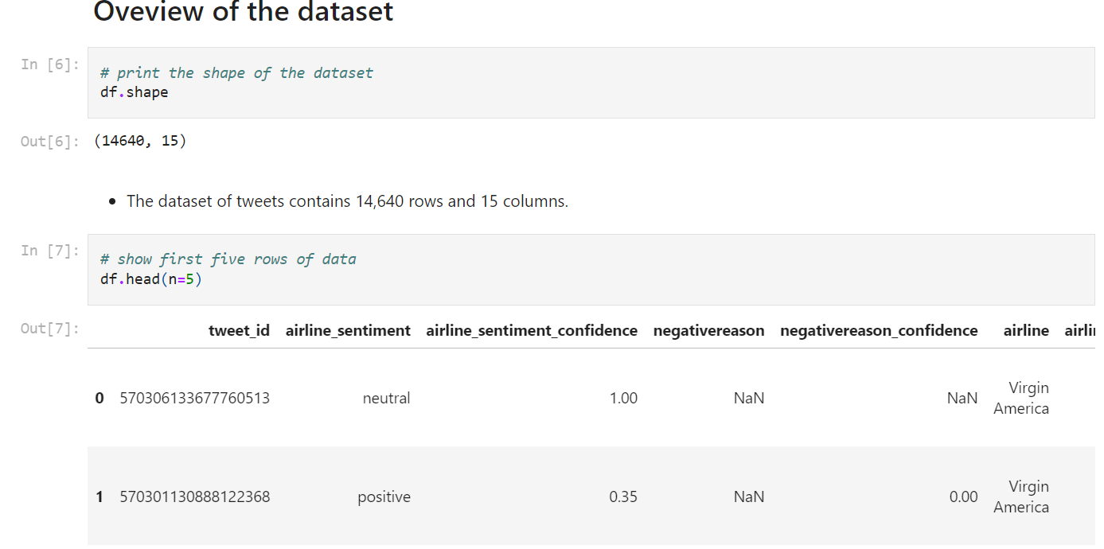

Slide 10
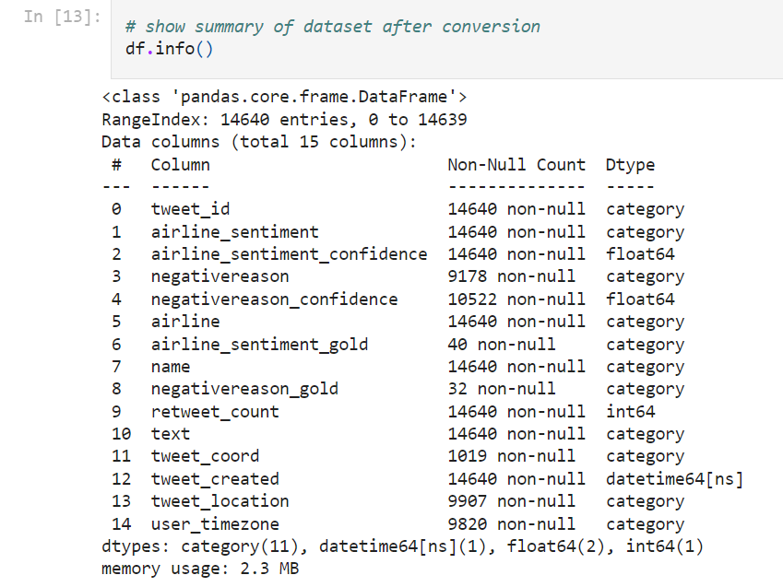
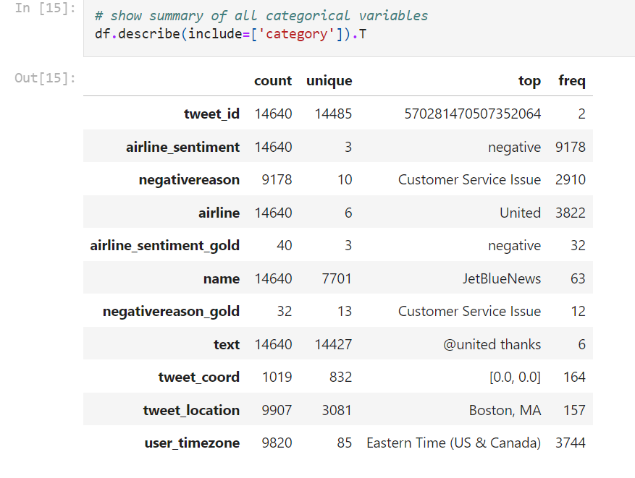

Slide 11
Approach
We are using single-layer bidirectional LSTMs, the model processes the input sequence in both directions—considering both past and future time steps simultaneously. This bidirectional processing allows the model to capture dependencies and patterns from both directions, providing a more comprehensive understanding of the sequence to capture context. Since our dataset has around 14,485 tweets, a single-layer LSTM might be more efficient and less prone to overfitting. We are planning to use Bahdanau Attention mechanism given the nature of sentiment analysis in tweets, where sentiment can be influenced by different parts of the text, starting with Bahdanau Attention could be a reasonable choice for us. It allows the model to dynamically attend to different words in a tweet, capturing the nuanced and context-dependent nature of sentiment in short texts.

Slide 12
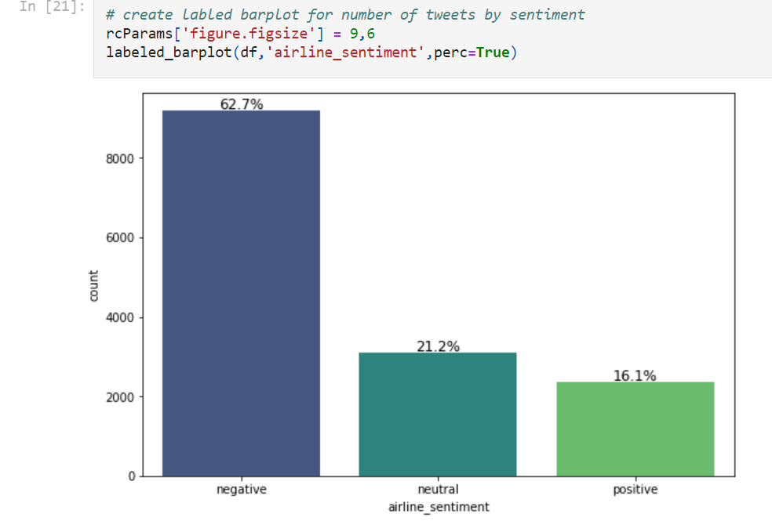
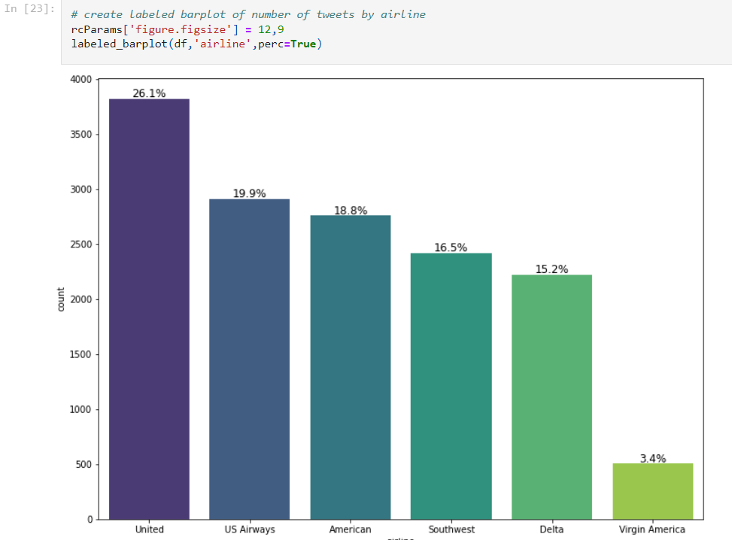

Slide 13
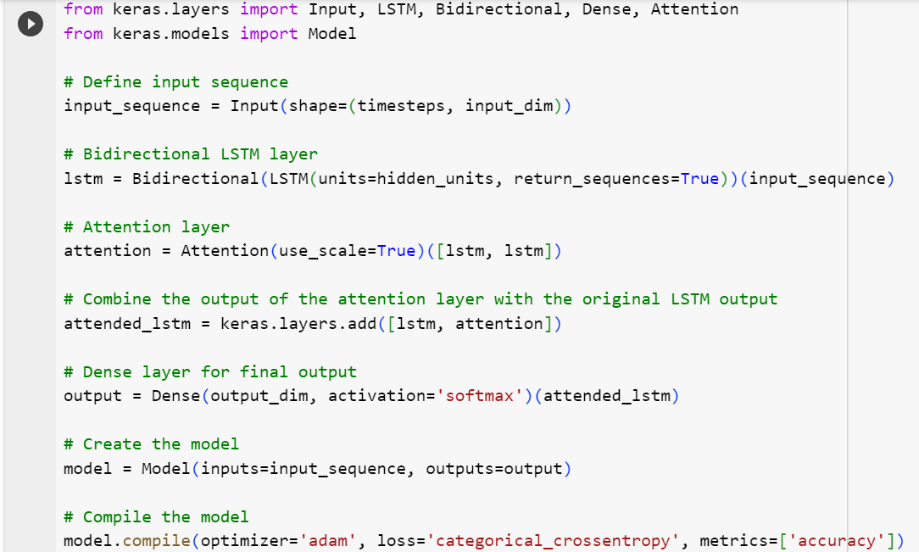
Basic Code of LSTM Single Layer Bidirectional with Attention

Slide 14

Performance & Evaluation
Evaluation metrics include accuracy, precision, recall, and F1 score. Our project will conduct a comprehensive performance comparison of LSTM architectures and assess the effectiveness of attention mechanisms .
For Evaluation, we use Anova or Adam test.

